Slide 1
Machine learning for physics

Slide 2
What is machine learning?
From Wikipedia:
Machine learning is a study of algorithms and statistical models that computers use to perform tasks without explicit instructions
Or…
It is basically a computer programming without (or almost without) rule-based algorithms
Machine learning is a subset of Artificial Intelligence
Notes:
То есть иными словами ML применяется в тех случаях, когда или невозможно или нецелесообразно разрабатывать традиционный алгоритм. Потребуется слишком много рукописных правил и исключений. Примеры: распознавание изображений, оцифровка рукописного текста, машинный перевод, фильтрация спама.

Slide 3
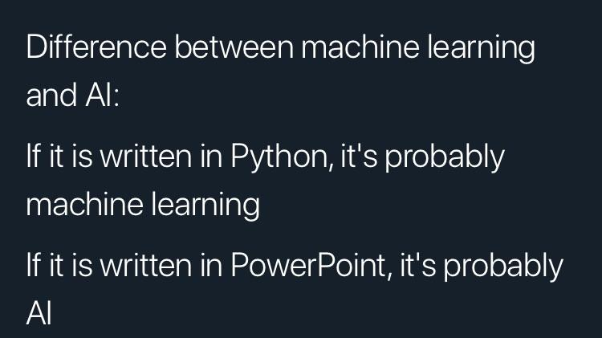

Slide 4

https://www.edureka.co/blog/ai-vs-machine-learning-vs-deep-learning/

Slide 5

Several types of learning algorithms
https://www.wordstream.com/blog/ws/2017/07/28/machine-learning-applications

Slide 6
More details. Supervised learning.
Given:
Some problem
Training examples with correct labels -> Training set
Performance measure -> Objective function
Task:
Find some function (usually nonlinear) to predict correct outputs (according to the objective) on the unseen inputs (test set).

Slide 7

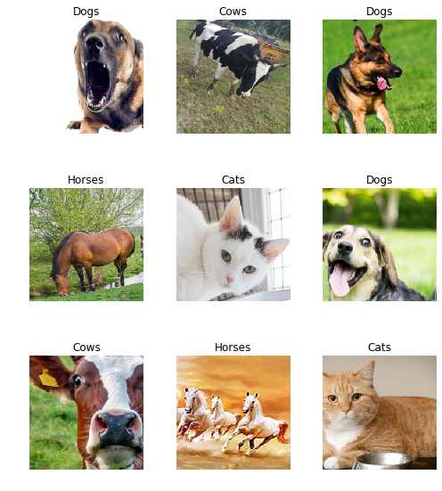
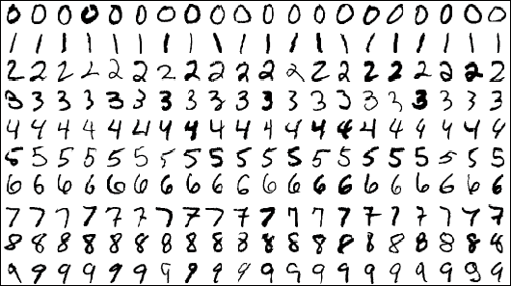
More details. Supervised learning. Examples

Slide 8
More details. Unsupervised learning.
Given:
Some data without labels -> Training set
Task:
Find some structure in the training set

Slide 9

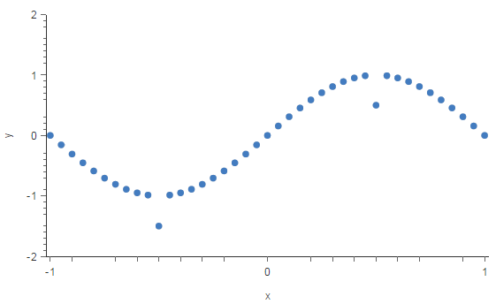
More details. Unsupervised learning. Examples

Slide 10
More details. Reinforcement learning.
Given
Some environment with deterministic or stochastic dynamics
An agent which acts in the environment, observes its current state and receives either positive or negative signals after different actions (rewards)
Task
Train the agent to maximize total cumulative reward during episodes undertaken in the environment

Slide 11

More details. Reinforcement learning. Examples
Game AI (AlphaGo and AlphaZero)
Self-driving cars
Combinatorial optimization
Decision making

Slide 12
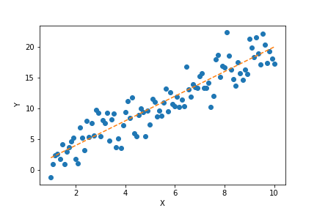
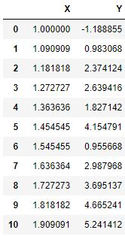
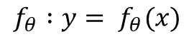
Linear regression
Supervised learning task. Find
Training set:
$$f_{θ} :y= f_{θ}(x)$$
Notation:
m – number of training examples
x – input (features)
y – output

Slide 13
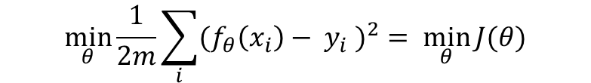
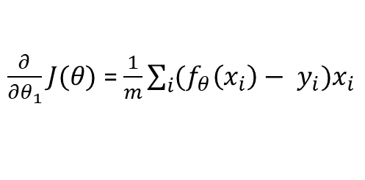
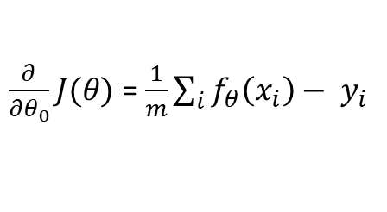
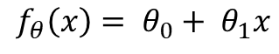
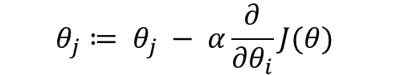
Cost function
MSE:
$$\min_{θ}{\frac{1}{2m}\sum_{i}{{(f_{θ}\left(x_{i}\right)− y_{i} )}^{2}}= \min_{θ}{J(θ)}}$$
Gradient descent:
$$θ_{j}≔ θ_{j} − α\frac{∂}{{∂θ}_{i}}J(θ)$$
Hypothesis:
$$f_{θ}\left(x\right)= θ_{0}+ θ_{1}x$$
Gradients:
$\frac{∂}{{∂θ}_{0}}J(θ)$ = $\frac{1}{m}\sum_{i}{f_{θ}\left(x_{i}\right)− y_{i}}$
$\frac{∂}{{∂θ}_{1}}J(θ)$ = $\frac{1}{m}\sum_{i}{(f_{θ}\left(x_{i}\right)− y_{i})x_{i}}$
Batched gradient descent

Slide 14
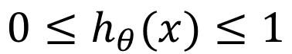
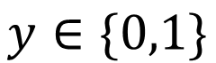
Classification
Cat or dog?
Spam or not?
Pedestrian or car?
Supervised task. We have training set.
0 – negative class
1 – positive class
$$y∈\{0,1\}$$
Hypothesis:
$$0≤h_{θ}(x)≤1$$

Slide 15
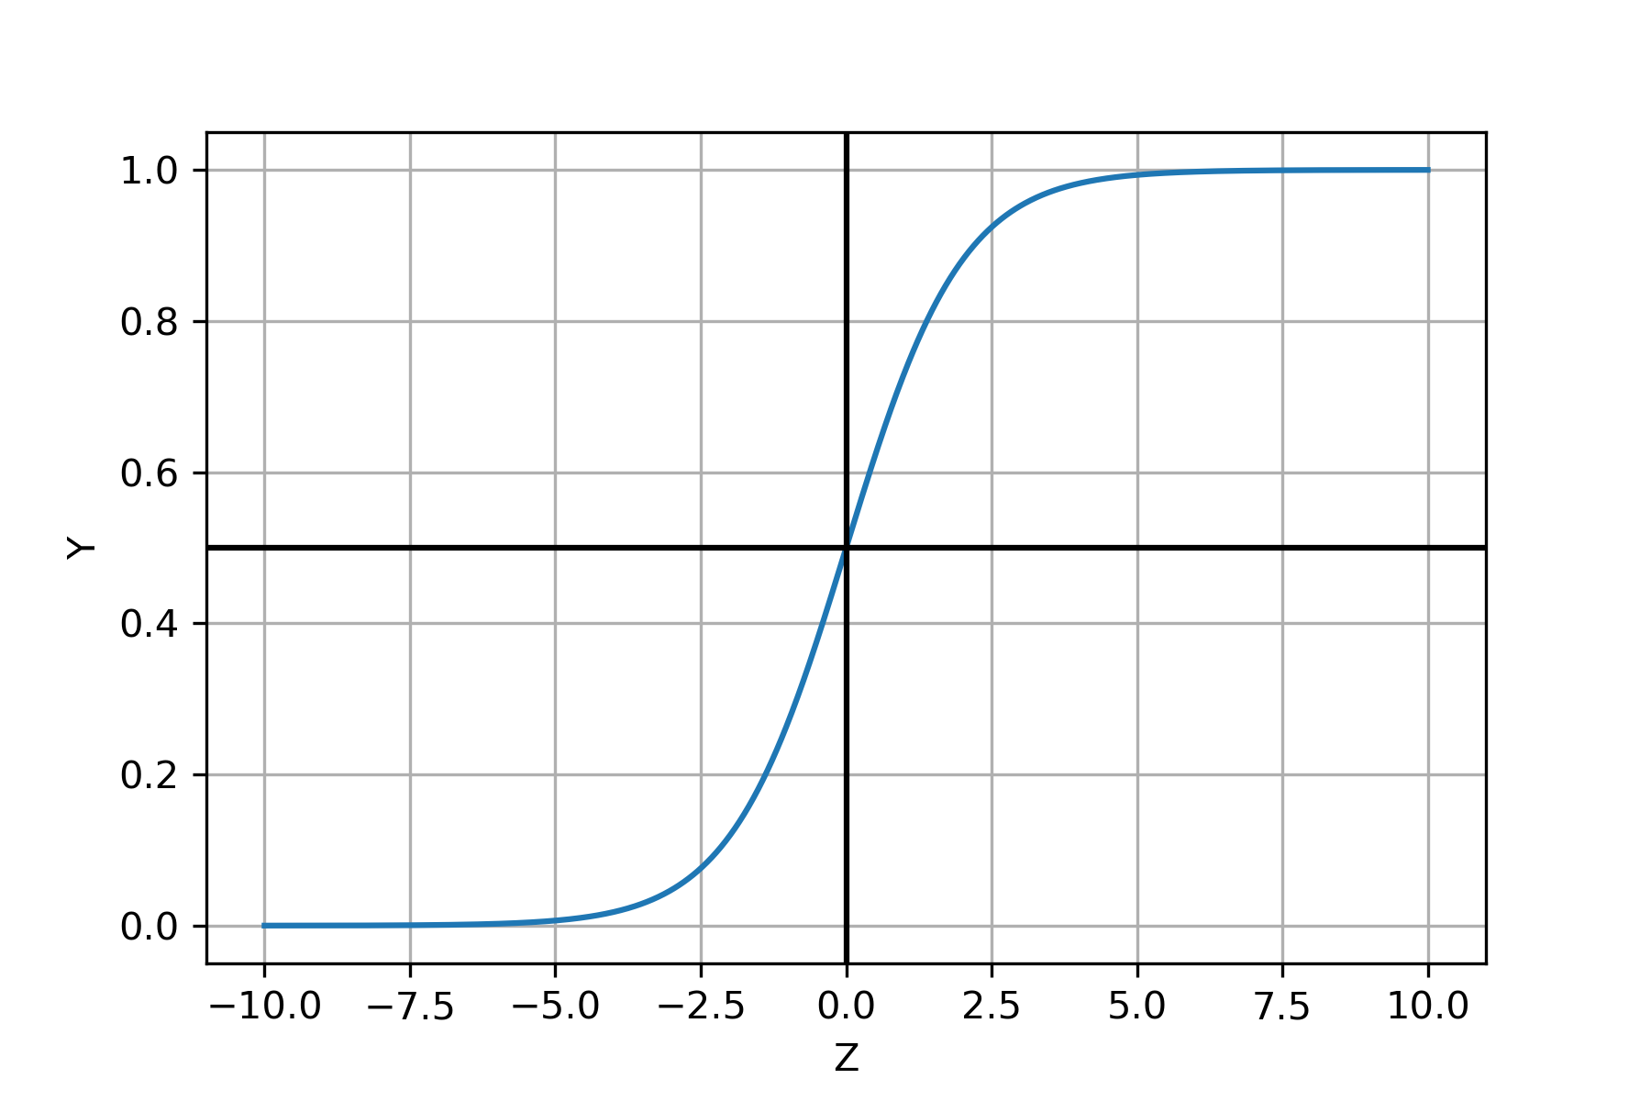
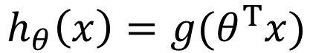
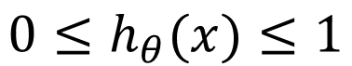
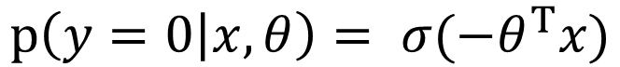
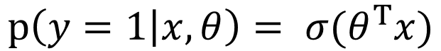
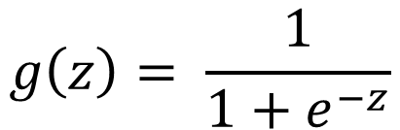
Logistic regression model
Task:
$$0≤h_{θ}(x)≤1$$
$$g\left(z\right)= \frac{1}{1+e^{−z}}$$
Sigmoid or logistic function
Hypothesis:
$$h_{θ}\left(x\right)=g(θ^{T}x)$$
$$h_{θ}\left(x\right)≥0.5 →y=1,θ^{T}x>0$$
$$h_{θ}\left(x\right)<0.5 →y=0,θ^{T}x<0$$
Interpretation:
$${p\left(y=1 | x,θ\right)= σ(θ}^{T}x)$$
$${p\left(y=0 | x,θ\right)= σ(−θ}^{T}x)$$

Slide 16
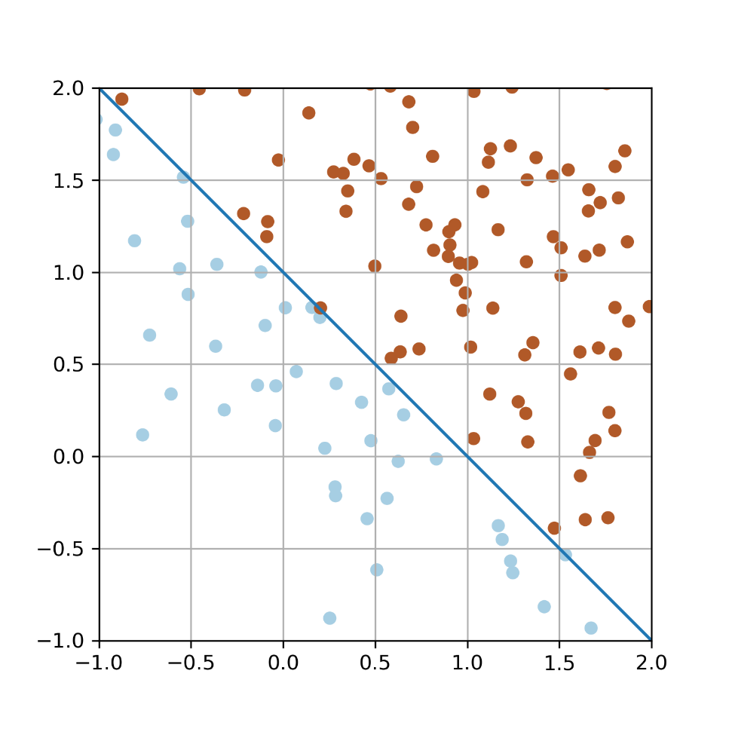
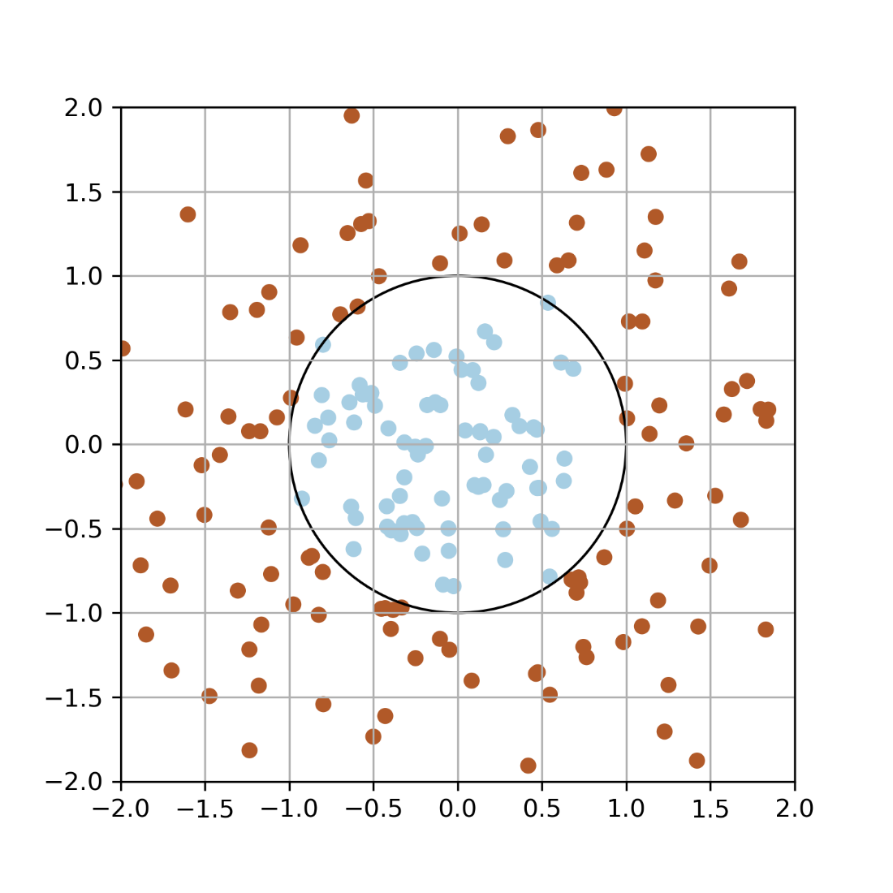
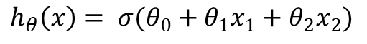
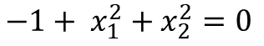
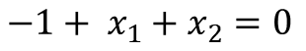
Linear regression. Decision boundary.
$$h_{θ}\left(x\right)= σ(θ_{0}+θ_{1}x_{1}+θ_{2}x_{2})$$
$$h_{θ}\left(x\right)= σ(θ_{0}+θ_{1}x_{1}+θ_{2}x_{2}+θ_{3}x_{1}^{2}+θ_{4}x_{2}^{2})$$
$$−1+ x_{1}+x_{2}=0$$
$$−1+ x_{1}^{2}+x_{2}^{2}=0$$

Slide 17
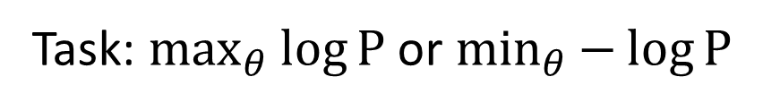
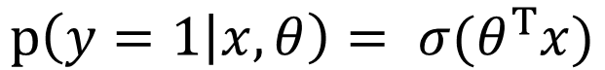
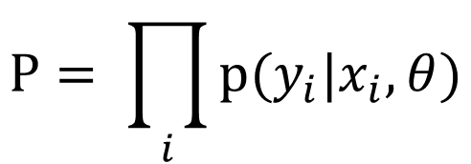
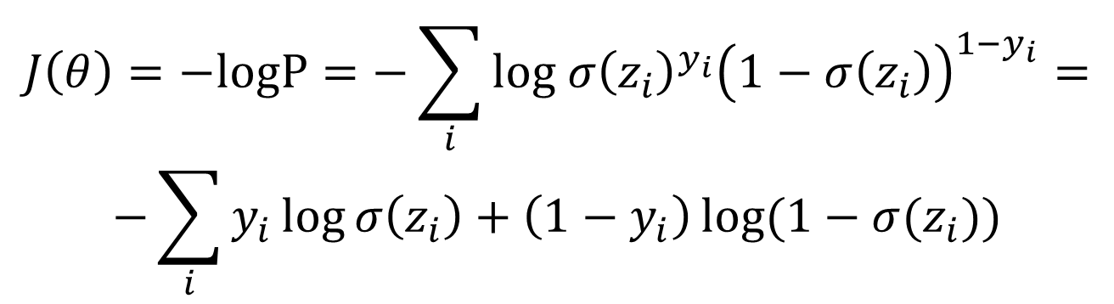
Cost function
$${p\left(y=1 | x,θ\right)= σ(θ}^{T}x)$$
$$p\left(y | x,θ\right)={σ(z)}^{y}{(1−σ(z))}^{1−y}$$
$${p\left(y=0 | x,θ\right)=1− σ(θ}^{T}x)$$
$$P= \prod_{i}{p(y_{i}|x_{i},θ)}$$
Likelihood of the training set:
Task: $\max_{θ}{\log{P}}$ or $\min_{θ}{−\log{P}}$
$$J\left(θ\right)=−logP=−\sum_{i}{log{ σ\left(z_{i}\right)}^{y_{i}}{\left(1−σ\left(z_{i}\right)\right)}^{1−y_{i}}}=$$
$$−\sum_{i}{y_{i}\log{σ\left(z_{i}\right)+\left(1−y_{i}\right)\log{(1−σ(z_{i}))}}}$$

Slide 18
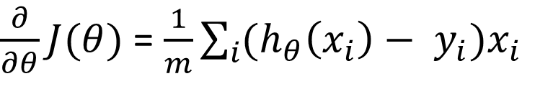
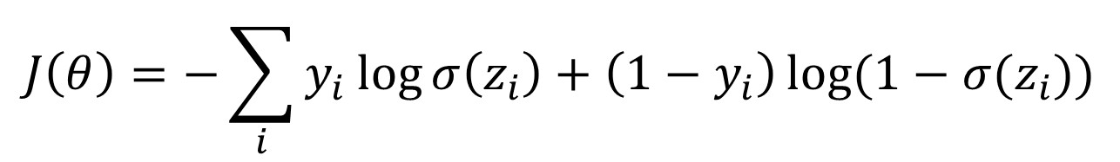
Derivative of cost
$$J\left(θ\right)=−\sum_{i}{y_{i}\log{σ\left(z_{i}\right)+\left(1−y_{i}\right)\log{(1−σ(z_{i}))}}}$$
$\frac{∂}{∂θ}J(θ)$ = $\frac{1}{m}\sum_{i}{(h_{θ}\left(x_{i}\right)− y_{i})x_{i}}$
Exactly the same as for linear regression

Slide 19
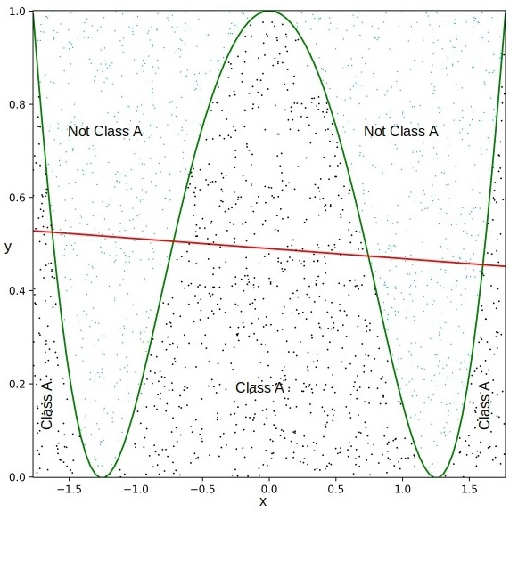
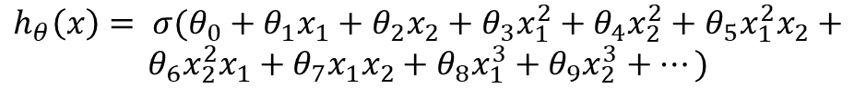
Non-linear decision boundary
What if the decision boundary is strongly nonlinear?
Feature hand-engineering
$$h_{θ}\left(x\right)= σ(θ_{0}+θ_{1}x_{1}+θ_{2}x_{2}+θ_{3}x_{1}^{2}+θ_{4}x_{2}^{2}+θ_{5}x_{1}^{2}x_{2}+$$
$$θ_{6}x_{2}^{2}x_{1}+θ_{7}x_{1}x_{2}+θ_{8}x_{1}^{3}+θ_{9}x_{2}^{3}+…)$$
Too many terms -> not practical

Slide 20
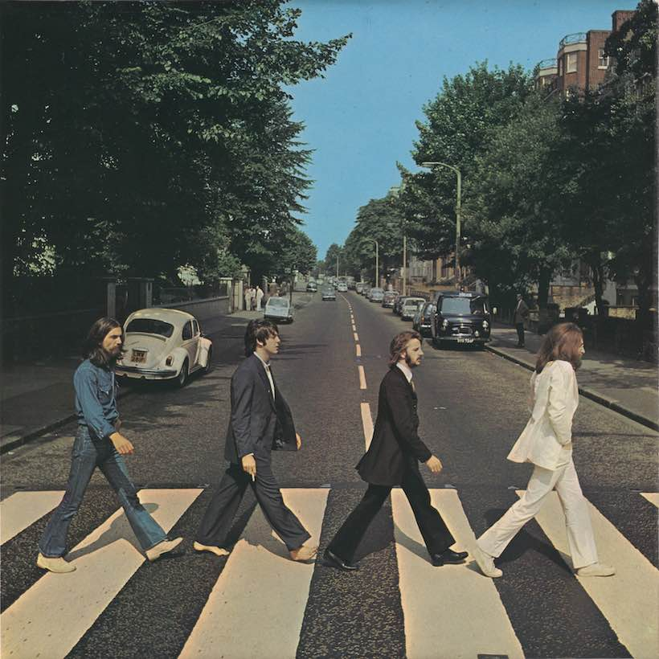
More sophisticated decision boundary
Vs.
Classification task
Feature hand-engineering is not practical at all for high-dimensional data

Slide 21


Slide 22
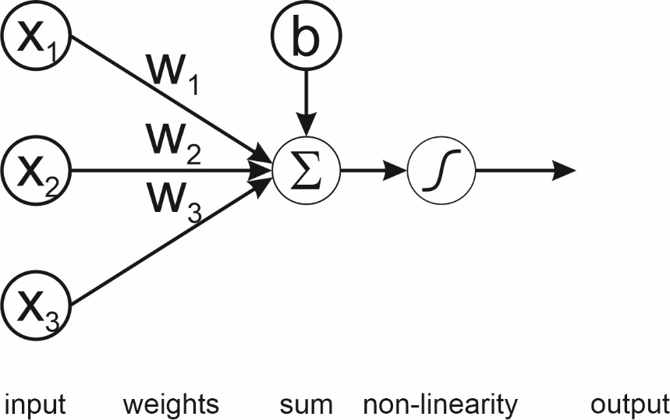
Neuron model. Basic logistic unit.
$$h_{w}\left(x\right)=g(w_{1}x_{1}+w_{2}x_{2}+w_{3}x_{3}+b)$$

Slide 23

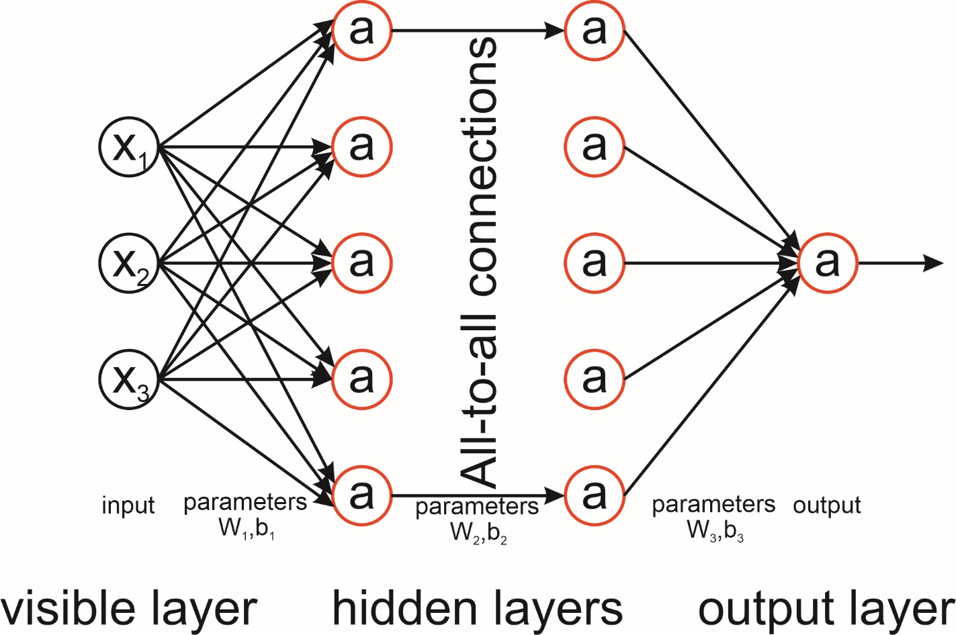
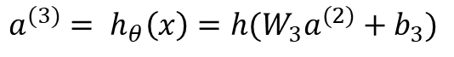
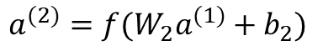
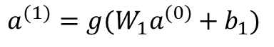
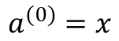
Neural network. One output.
$$a^{(0)}=x$$
$$a^{(1)}=g(W_{1}a^{(0)}+b_{1})$$
$$a^{(2)}=f(W_{2}a^{(1)}+b_{2})$$
$$a^{(3)}= h_{θ}\left(x\right)=h(W_{3}a^{(2)}+b_{3})$$

Slide 24
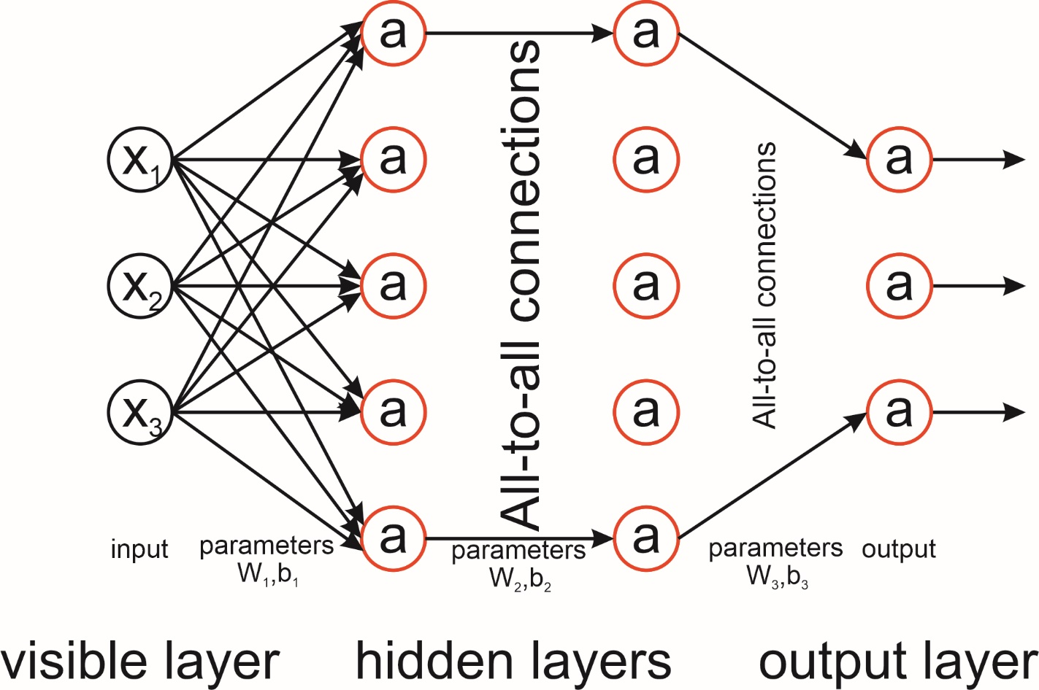
Neural network. Many outputs

Slide 25
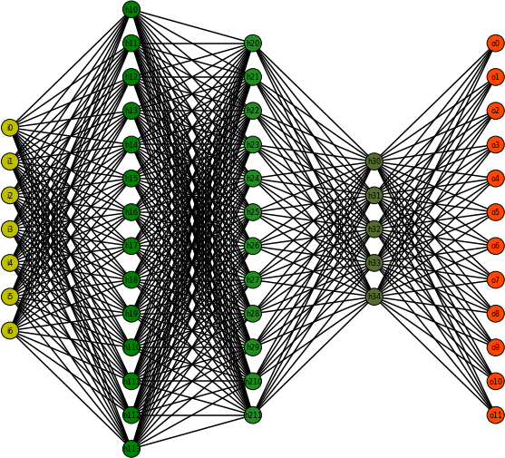
Neural network. Many outputs.

Slide 26
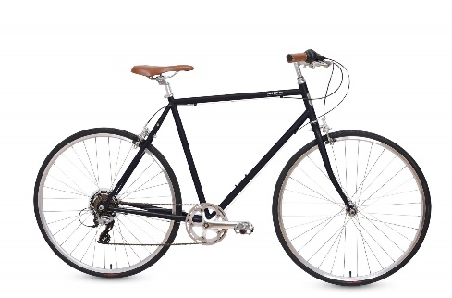

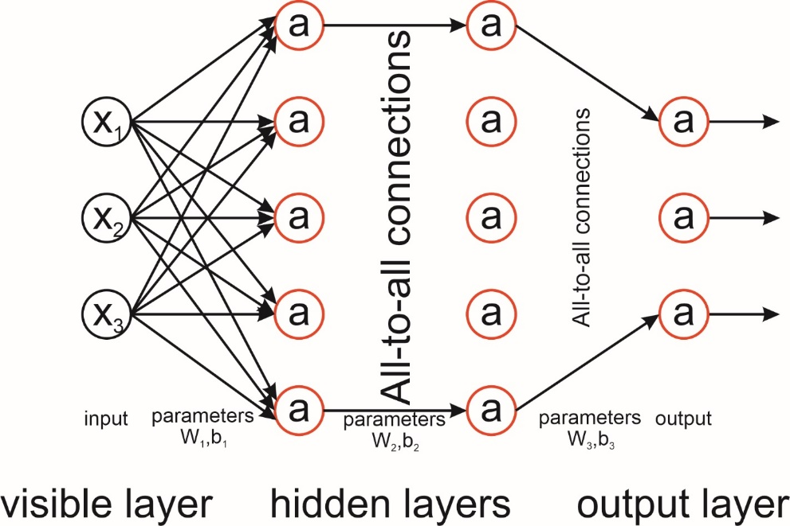
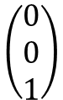
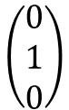
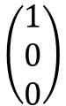
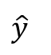
Neural network. Multi-class classification
$$\hat{y}$$
Pedestrian
Bicycle
Car
$$\left(\begin{matrix}1 \\ 0 \\ 0\end{matrix}\right)$$
$$\left(\begin{matrix}0 \\ 1 \\ 0\end{matrix}\right)$$
$$\left(\begin{matrix}0 \\ 0 \\ 1\end{matrix}\right)$$
One-hot encoding

Slide 27
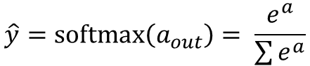
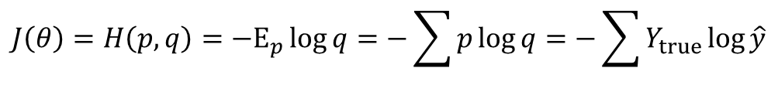
Neural network. Multi-class classification cost
Output -> softmax:
$$\hat{y}=softmax\left(a_{out}\right)= \frac{e^{a}}{\sum{e^{a}}}$$
Interpretation: NN predicts probabilities
We have ground-truth probability distribution defined by the training set
Our NN predicts another probability distribution
Our goal is to minimize divergence between these two distributions
The natural cost function, in this case, is KL-divergence or cross-entropy.
$$J\left(θ\right)=H\left(p,q\right)=−E_{p}\log{q}=−\sum{p\log{q}}=−\sum{Y_{true}}\log{\hat{y}}$$

Slide 28







Gradients calculation. Backpropagation algorithm
$$a^{(0)}=x$$
$$a^{(1)}=g(W_{1}a^{(0)}+b_{1})$$
$$a^{(2)}=g(W_{2}a^{(1)}+b_{2})$$
$$a^{(3)}=g(W_{3}a^{(2)}+b_{3})$$
$$\hat{y}=softmax\left(a_{out}\right)= \frac{e^{a}}{\sum{e^{a}}}$$
$$J\left(θ\right)=−\sum{Y_{true}}\log{\hat{y}}$$
The task is to calculate the gradients of cost function with respect to NN parameters.
It is simply a differentiation of a complex function

Slide 29








Backward path
$$a^{(3)}=g(W_{3}a^{(2)}+b_{3})$$
$$\hat{y}=softmax\left(a_{out}\right)= \frac{e^{a}}{\sum{e^{a}}}$$
$$J\left(θ\right)=−\sum{Y_{true}}\log{\hat{y}}$$
$$\frac{∂J}{∂a^{(3)}}= \hat{y}−Y_{true}=δ^{(3)}$$
$\frac{∂J}{∂W^{(2)}}$= $\frac{∂J}{∂a^{(3)}}\frac{∂a^{(3)}}{∂W^{(2)}}=δ^{(3)}a^{\left(2\right)T}$
$\frac{∂J}{∂b^{(2)}}$ = $\frac{∂J}{∂a^{(3)}}\frac{∂a^{(3)}}{∂b^{(2)}}=δ^{(3)}$
$\frac{∂J}{∂a^{(2)}}$ = $\frac{∂J}{∂a^{(3)}}\frac{∂a^{(3)}}{∂a^{(2)}}={W^{\left(2\right)T}δ}^{(3)}= δ^{(2)}$
$$\frac{∂J}{∂z^{(2)}}= δ^{(2)}\left\{\begin{aligned}1, if z^{(2)}≥0 \\ 0, if z^{(2)}<0\end{aligned}\right.$$

